Slide 1
SMART ENERGY MONITORING APPLICATION
BY:
(BATCH 1)
Preethi.S - 211417104200
Sangavi Priyaa. M - 211417104237
Shanmugam Mithra - 211417104253
Guide: Dr.L.Jaba Sheela,
Professor, Department of CSE,
Panimalar Engineering College

Slide 2
INTRODUCTION
Internet of Things (IoT) is revolutionizing Industries faster than ever.
IoT is the network of physical objects or things embedded with electronics and sensors.
Real –time monitor of power consumption in buildings.
Take intelligent decisions using concept of IoT.
Build powerful systems and applications by using wi-fi devices and LTE modems.
Mainly uses the concept of IOT to monitor real time data.

Slide 3
LITERATURE SURVEY
YEAR OF PUBLISHING | AUTHOR NAME | TITLE OF THE PAPER | MERITS | DEMERITS
2019 https://ieeexplore.ieee.org/document/8777607 | Satyendra K. Vishwakarma ,Prashant Upadhyaya ,Babita Kumari,Arun Kumar Mishra | Smart Energy Efficient Home Automation System Using IoT | The advantage of Google assistance and web based application can be helpful in controlling the appliance of the system. Thus, the proposed model is designed to provide better flexibility and making the system more robust. | 1. There is no EEPROM chip used to store critical machine data’s during power failures 2. Instead of wifi, Bluetooth technology is used which leads to limited device controlling distance
2019 https://ieeexplore.ieee.org/document/8844945 | Harsh Kumar Singh; Saurabh Verma; Shashank Pal; Kavita Pandey | A step towards Home Automation using IOT | IOT using microcontroller. NodeMCU (ESP8266) microcontroller along with Relays is used to control electrical switches remotely from the server which is built on Node.js. User can control switches using a Web Application after authenticating. | No protection circuit added to connected devices to prevent voltage spikes No MOSFET used for fast switching and endurance This device can control only home appliance only and incompatible for sensitive devices
2019 https://ieeexplore.ieee.org/document/8372548 | Majid Al-Kuwari, Abdulrhman Ramadan, Yousef Ismael, Laith Al-Sughair, Adel Gastli, | Smart-home automation using IoT-based sensing and monitoring platform | The sensing of different variables inside the house is conducted using the NodeMCU-ESP8266 microcontroller board. Realtime data sensing, processing and uploading/downloading to/from the EmonCMS cloud server A system can be set to monitor these parameters to help maintain them within an acceptable range. | Can be used for monitoring small homes only. Not suitable for large buildings No secured Authentication over controlling via internet
2018 https://ieeexplore.ieee.org/document/8417153 | Heiko Koziolek; Andreas Burger; Jens Doppelhamer | Self-Commissioning Industrial IoT-Systems in Process Automation: Reference Architecture | PnP in IIoT systems, which is based on OPC UA and PLCopen standards and can reduce industrial device commissioning times across vendor products to a few seconds. It can handle more than 500 signals per millisecond during runtime, sufficient for most application scenarios. | 1. Since cable is used as interface between the IOT chip and Controller. Each and every time we need to plugin for making any changes in coding. 2. Devices can be controlled using laptop only. No provision given for controlling devices via android mobiles
2017 https://ieeexplore.ieee.org/document/8058302 | S.L.S. Sri Harsha; S. Chakrapani Reddy; S. Prince Mary | Enhanced Home Automation System using Internet of Things | To make the application more user friendly, smart energy efficient home automation system is proposed that can access and control the home equipments from every corner of the world. For this system, Internet connectivity module is attached to the main supply unit of the home system which can be accessed through the Internet | 1. Complex wiring method used which leads to more maintenance if any wire fault occurs 2. Unable to export data’s to other devices for Report generation.

Slide 4
PROBLEM STATEMENT
Can be used for monitoring small homes only. Not suitable for large buildings
Cannot deal with simultaneous Real-time monitoring of the machines and data upload to cloud server
Bluetooth technology is used which leads to limited device controlling distance
No MOSFET used for fast switching and endurance
Unable to export data’s to other devices for Report generation.

Slide 5
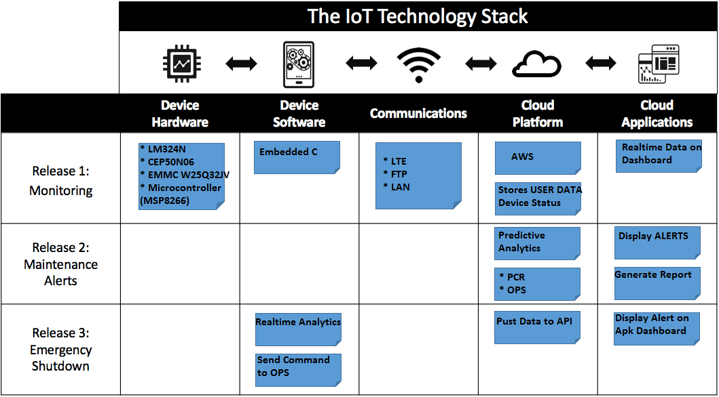
TECHNOLOGY STACK

Slide 6
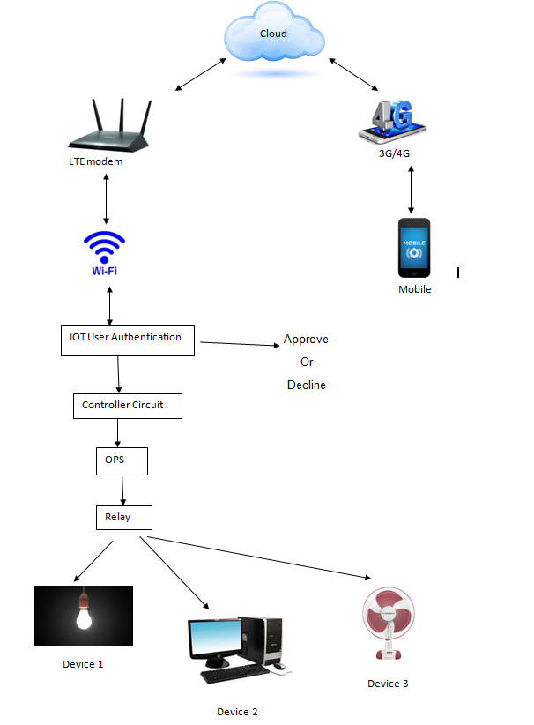
System Architecture

Slide 7
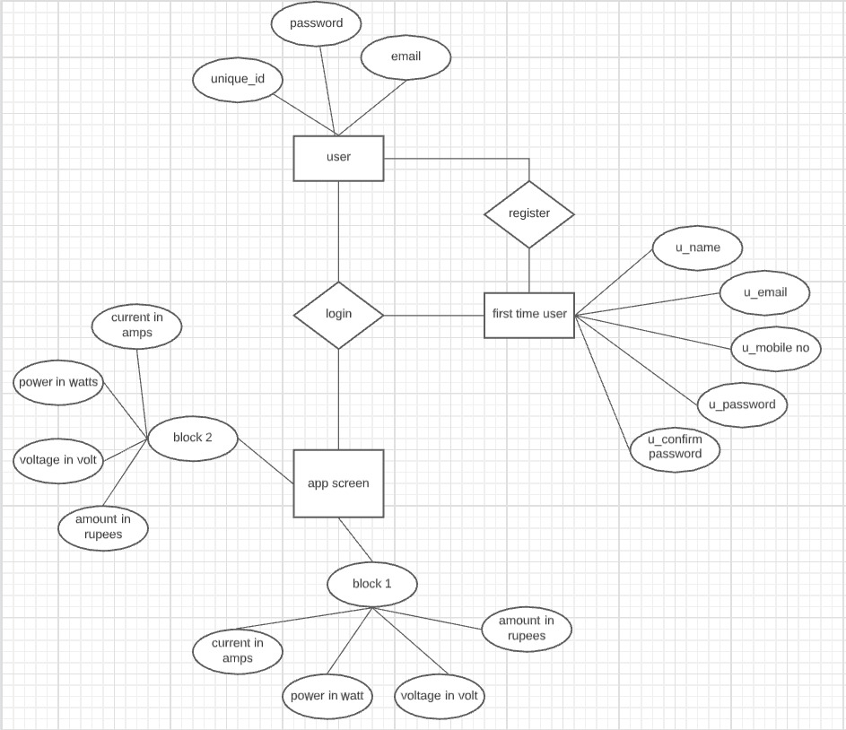
SYSTEM DESIGN-ER DIAGRAM
1
1

Slide 8
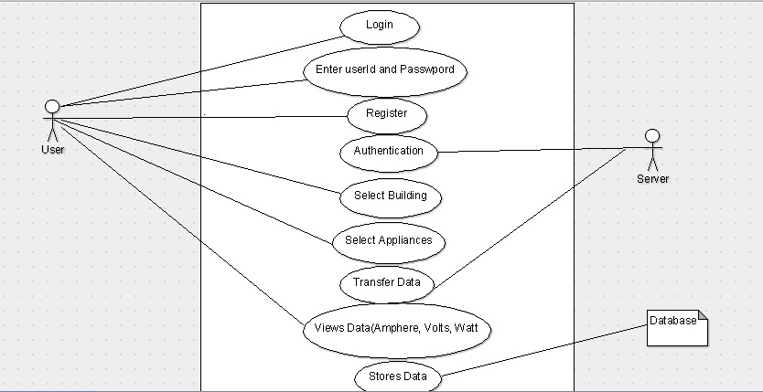
USECASE DIAGRAM

Slide 9
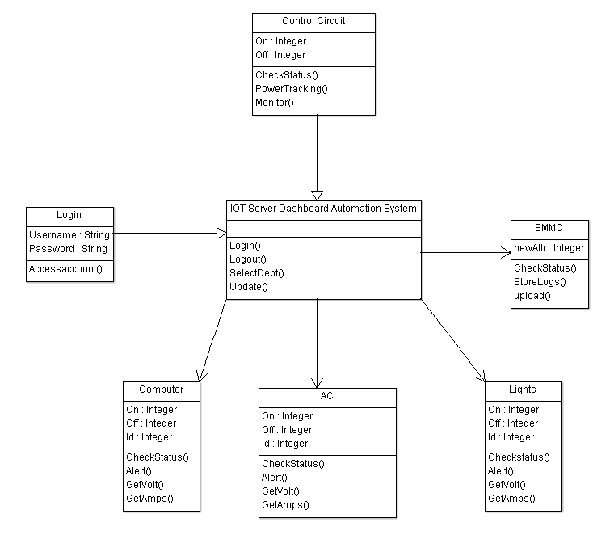
CLASS DIAGRAM

Slide 10
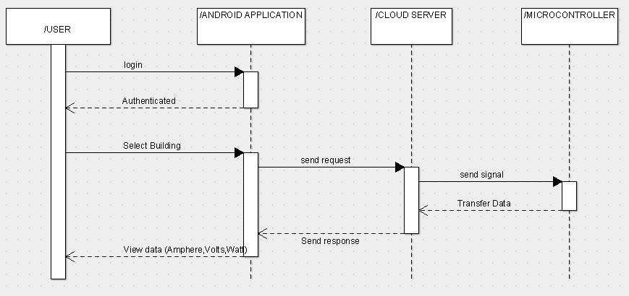
SEQUENCE DIAGRAM

Slide 11
Modules
Real Time Statistics Module
Power Consumption Recorder Module
Overload Production Service Module
Schedule Time Module

Slide 12
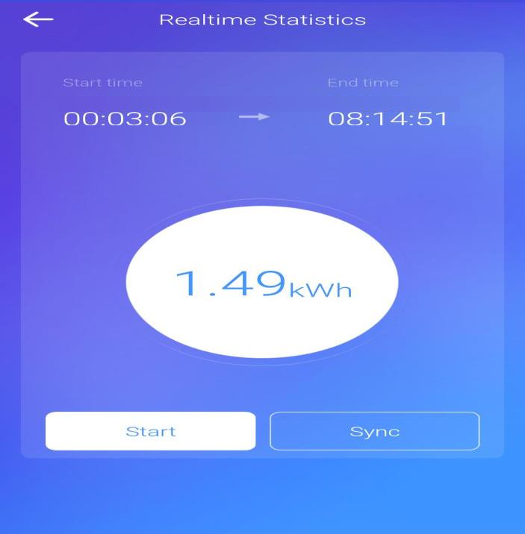
Real Time Statistics
Monitor current, voltage and power for appliances

Slide 13
Power Consumption Recorder
Displays entire power (i.e. voltage, current)
Avoid data loss during power cut
Records are synchronized to an EEPROM chip/SD card mounted to the microcontroller board.
power consumption is monitored and Stored as data logs
Data can be imported over Wi-Fi network/4G into MS Excel

Slide 14
Overload Production Service
Set maximum current, maximum power, minimum power values to protect the loads.
OPS module executes its function before operating the relays.
The relays switch according to the set value
The safety limit for the running appliances can be set.
If over voltage occurs ,OPS will send command to shoutdown the appliances

Slide 15
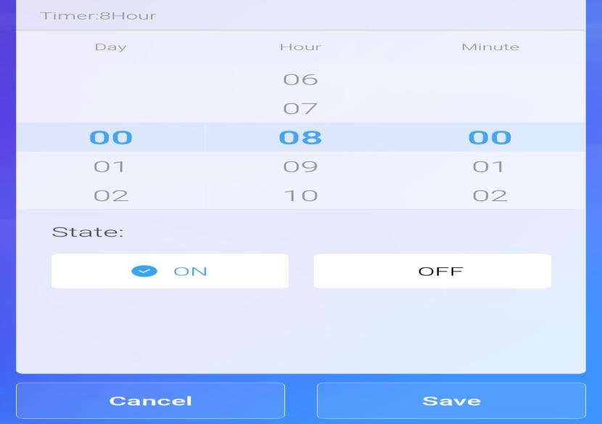
Schedule Time

Slide 16
Testing
S.NO | DEVICE/ FACTORS | THRESHOLD RANGE | EXISTING | PROPOSED OPS CIRCUIT
1. | Dektop PC | Upto 230 V | 230+/-20 | 230+/-1V
2. | Device 1/Fan | Upto 150 W | 150+/-30 | 150+/-2W
3. | Device 2/ Mobile charger | Upto 1.6 W | 1.6+/-1 | 1.6+/-1W
4. | Jet Motor | Upto 15A | 15+/-2A | 15+/-0.2A

Slide 17
Testing
It is possible to include many devices in our project but we have used four devices as sample.
As we can see from table , we can use devices like desktop PC, fan, and jet motor.
There is a threshold range for every device and we can set this value.
If the device voltage exceeds this limit then the device will shut down immediately.
Our project acts in such a way that even if the power exceeds by 1W, the device will shutdown automatically.

Slide 18
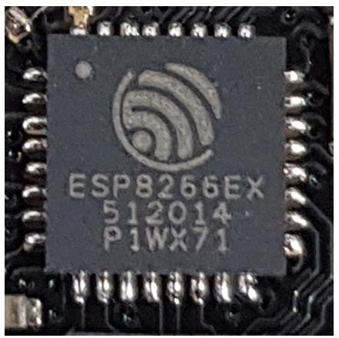
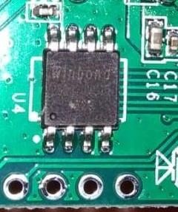
SCREENSHOTS - HARDWARE
EMMC Flash Memory W25Q32JV
MICROCONTROLLER-MSP8266

Slide 19
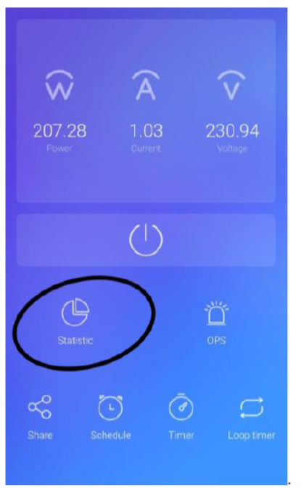
SCREENSHOTS-SOFTWARE
This Option enables to track down entire machine load details for a specified set time.

Slide 20
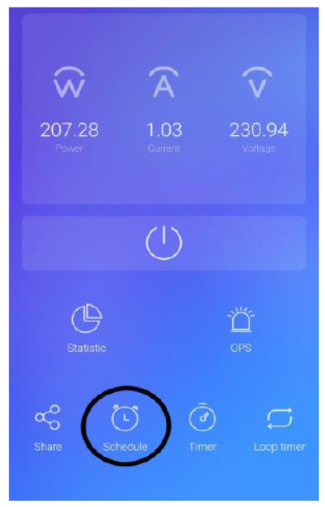
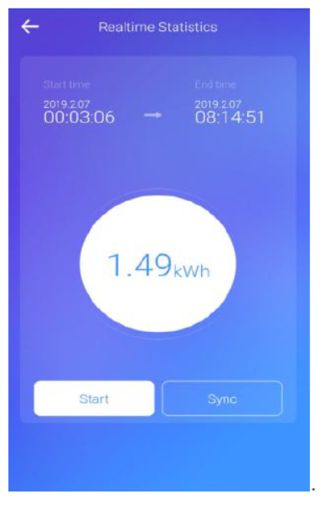
This enables administrator to set power scheduling of department. it can be programmed.
Tested load power details for 5hours 8 minutes

Slide 21
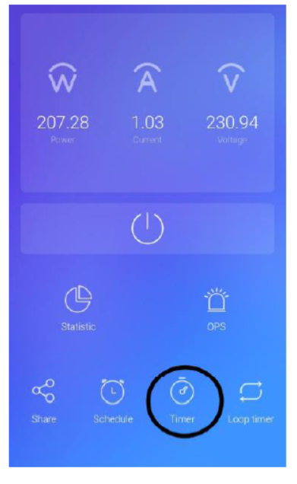
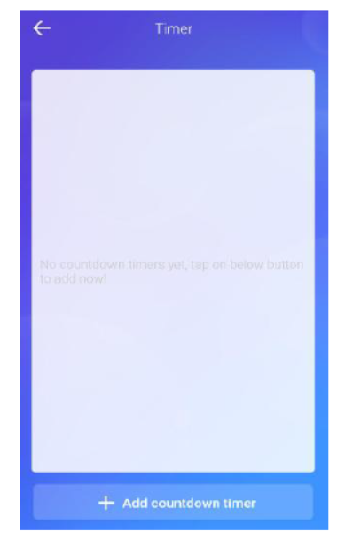
This enables IoT controller to run for a predefined countdown timer.eg if IoT clock timer is turned on at 9am and set countdown timer for normal work time 8 hours then this module triggers

Slide 22
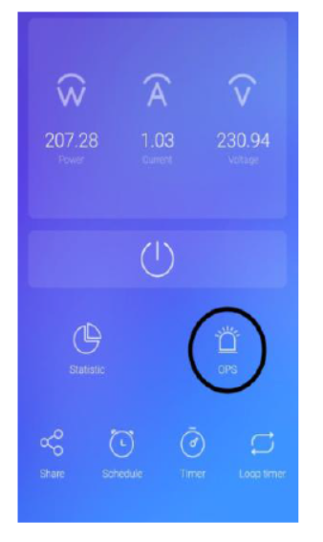
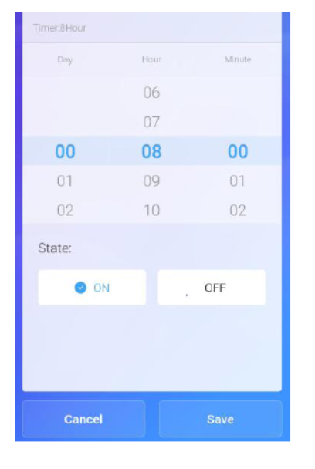
This Image showing 8 hour standard employee working hours.
OPS-Overload Protection Service

Slide 23
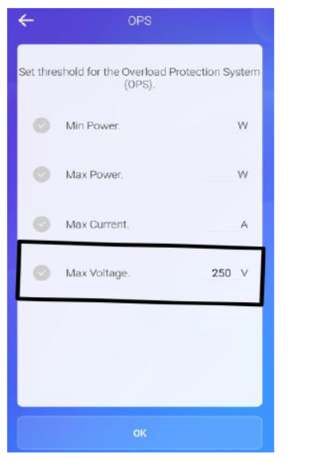
In OPS module safety limit for the running Appliances can be set. Eg. If volt limit is 250v AC then if any sudden overvoltage comes in power line this module sends immediate command to IoT main board relays to shut down the plant. Likewise safety amps and safety power threshold can be set

Slide 24
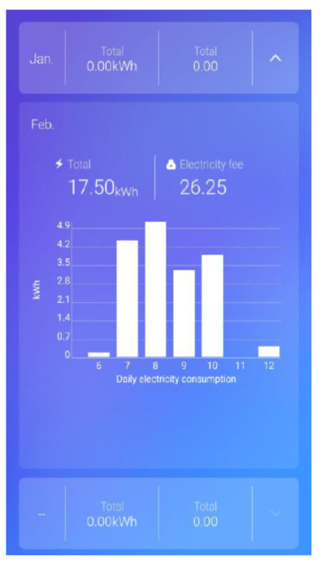
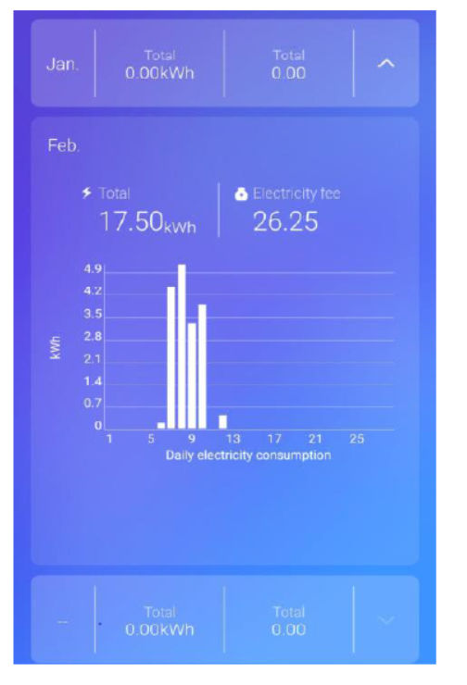
In PCR module entire power details are displayed in kwh and to avoid data loss during powercut this entire records are synced to a EEEPROM chip/SD card mounted to the sub PCB.
PCR-Power Consumption Recorder

Slide 25
CONCLUSION
This proposed system thus helps us to easily monitor the energy by a single application.
This system becomes more convenient in the future world of digital India and all over the world.
It reduces energy consumption and also detects an abnormality in consumption.
It is a better way to optimize cost.
Get real-time energy insights.
It reduces manpower which also reduces operational costs.
Helps in boosting the facility of performance and predicts future energy needs.

Slide 26
PUBLICATIONS:
Journal Name - International Journal of Creative Research Thoughts (IJCRT)
Paper Title- Smart Energy Monitoring Application
Publication Issue - Volume 9, Issue 5,
Date of Publication - 19-05-2021, 07:49:41
Published Paper URL - http://www.ijcrt.org/papers/IJCRT2105641.pdf

Slide 27
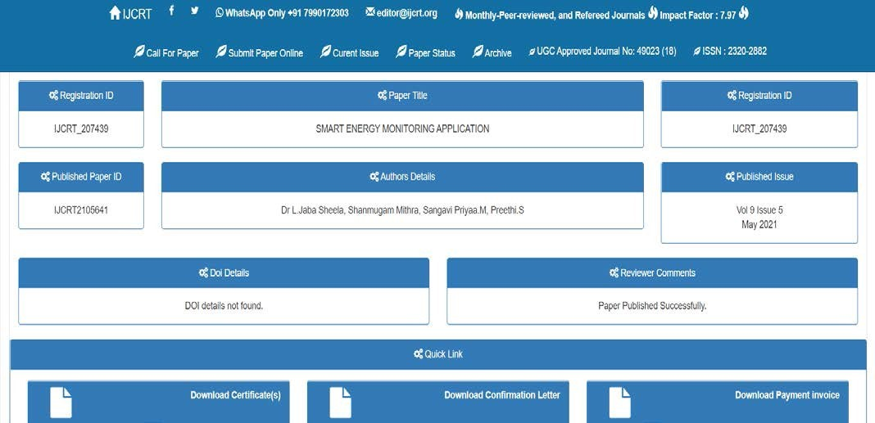

Slide 28
REFERENCES
[5] Satyendra K.Vishwakarma, Prashant Upadhyaya, Babita Kumari Arun Kumar Mishra,” Smart Energy Efficient Home Automation System Using IoT” -2019 (IEEE Paper)
[6] S.L.S. Sri Harsha; S. Chakrapani Reddy; S. Prince Mary, “Enhanced Home Automation System using Internet of Things”- 2017 (IEEE Paper)
[7] Harsh Kumar Singh; Saurabh Verma; Shashank Pal; KavitaPandey,” A step towards Home Automation using IOT” -2019( IEEE Paper)
[8] Majid Al-Kuwari, Abdulrhman Ramadan, Yousef Ismael, Laith Al-Sughair, Adel Gastli,” Smart-home automation using IoT-based sensing and monitoring platform”-2019(IEEE Paper)
[9] Sheela, L. J., R. Hemamalini, and M. Rejendran. "Cell phone the primary personal mobile computing devices." International Journal of Computer Trends and Technology 1.2 (2011): 87-90
[1] Marco Casini, “Internet of things for Energy efficiency of buildings,” International Scientific Journal Architecture and Engineering. – 2013
[2] Shu-ping Le, Hong Zeng, Jian Qiu, Song Zhang “Design and Implementation of Wireless Power Monitoring System for Public Buildings” - 2013 (IEEE Paper)
[3] S. Kumar and S. R. Lee, "Android-based smart home system with control via Bluetooth and internet connectivity," The 18th IEEE International Symposium on Consumer Electronics (ISCE 2014), Jeju Island, 2014, pp. 1-2.
[4] Heiko Koziolek; Andreas Burger; Jens Doppelhamer, “Self-Commissioning Industrial IoT-Systems in Process Automation: Reference Architecture” – 2018 (IEEE Paper)

Slide 29


